Slide 1
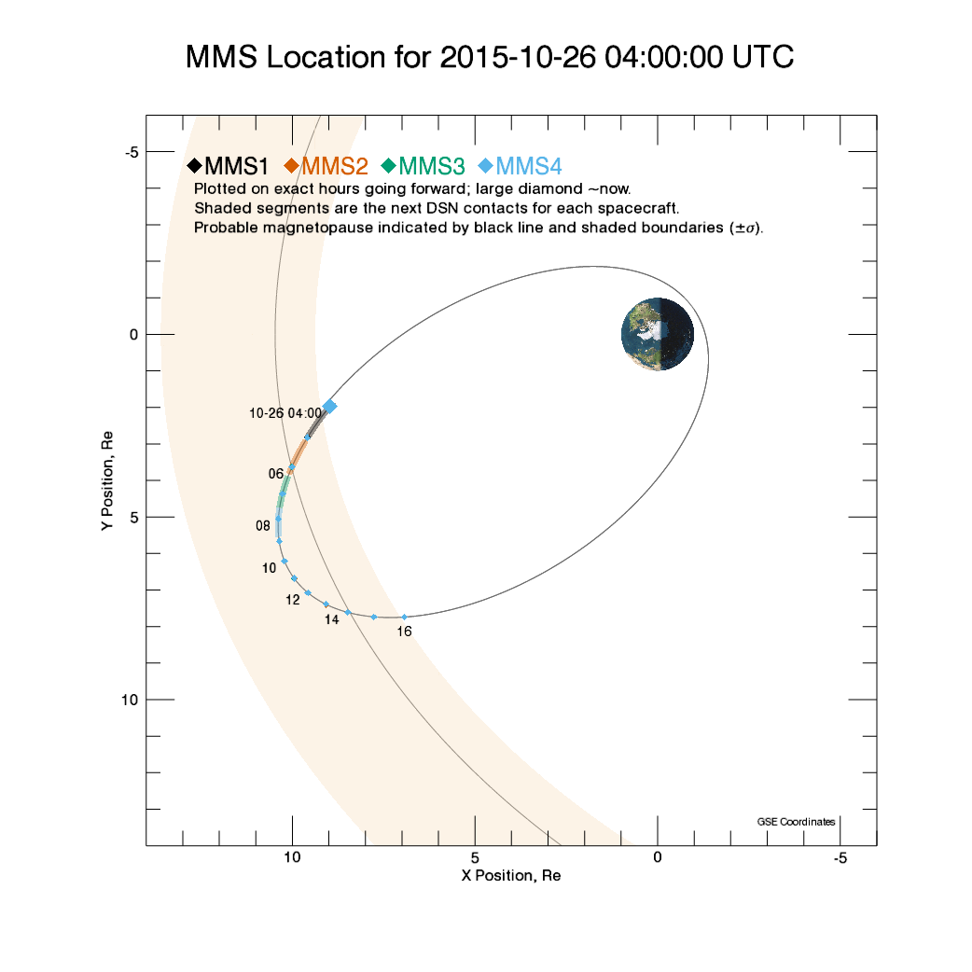
Spacecraft Location

Slide 2
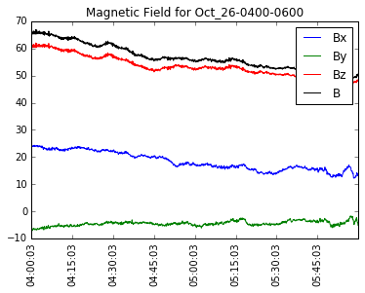
Magnetic Field

Slide 3
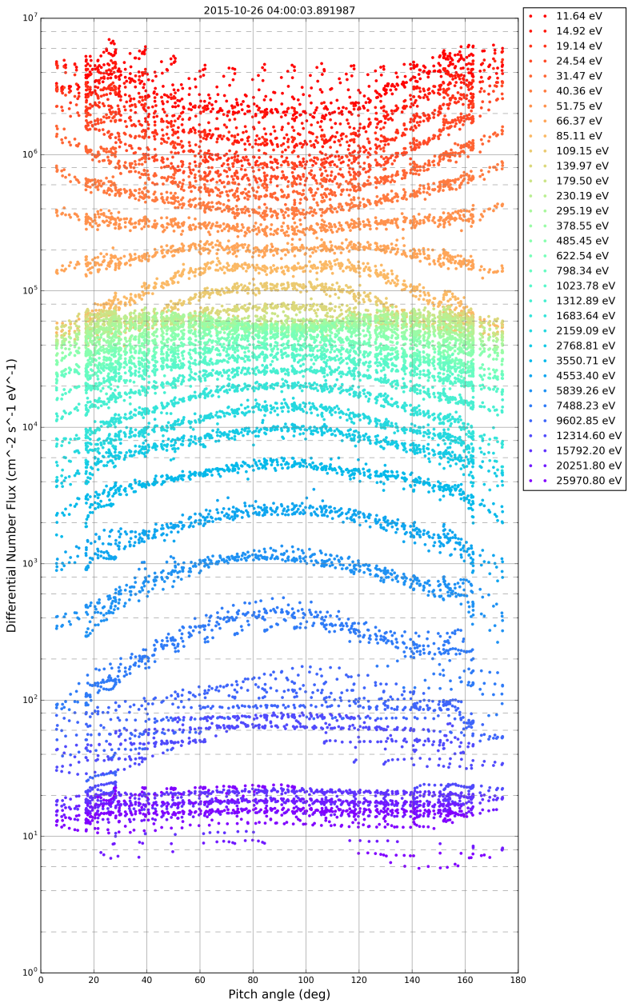
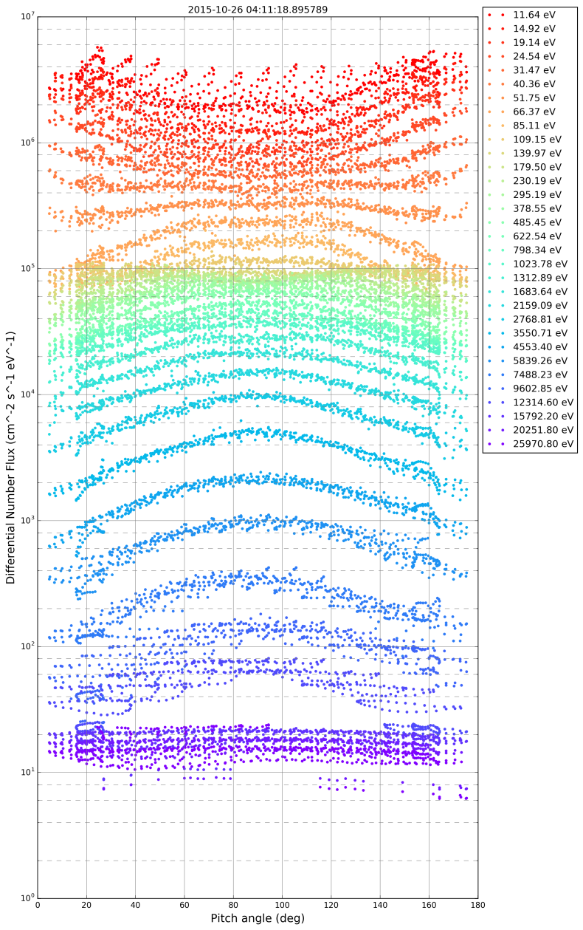
Raw PADs for Selected Times

Slide 4
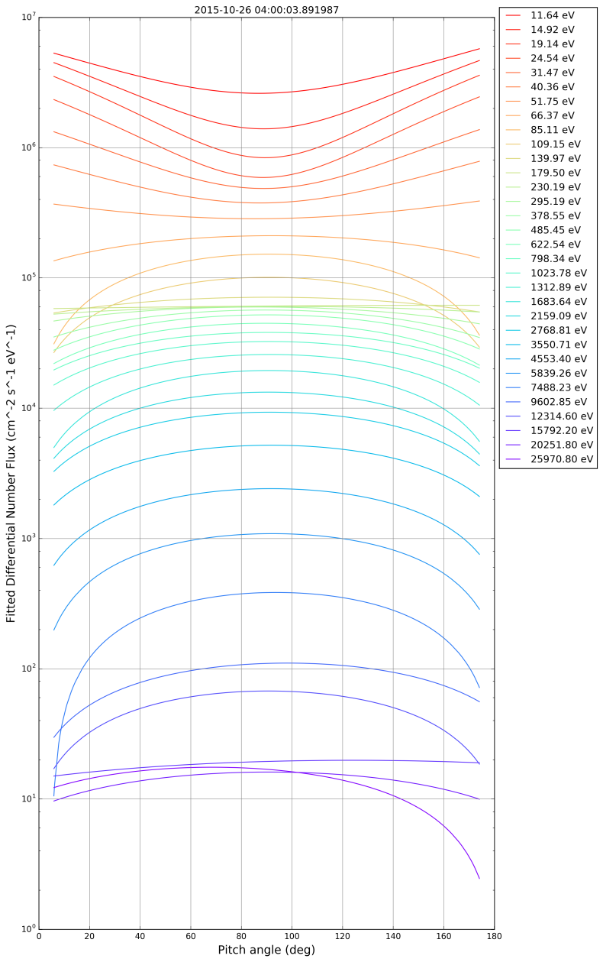
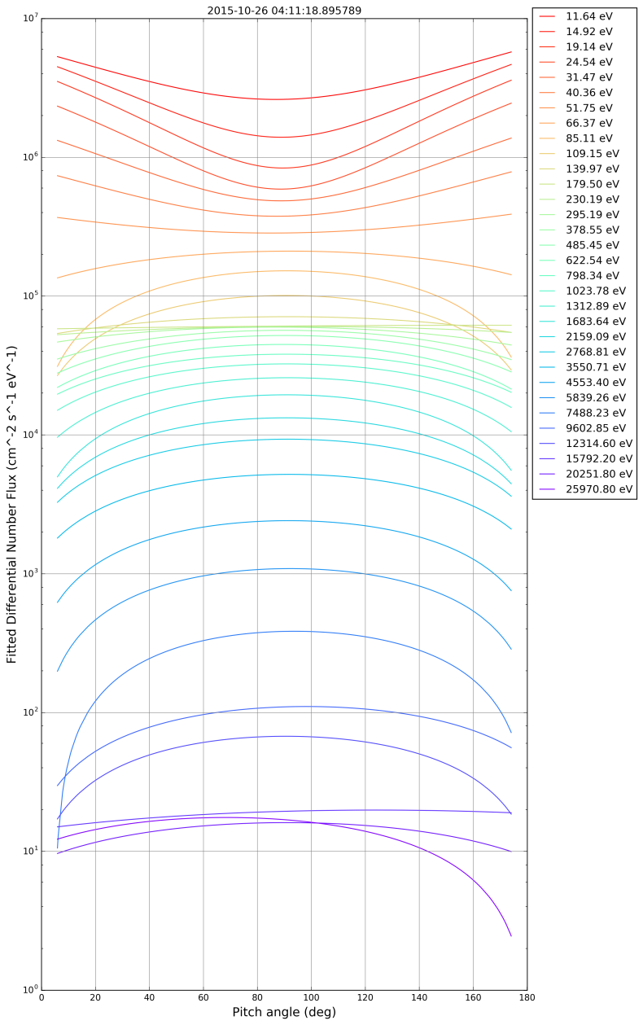
Smooth PADs for Selected Times

Slide 5
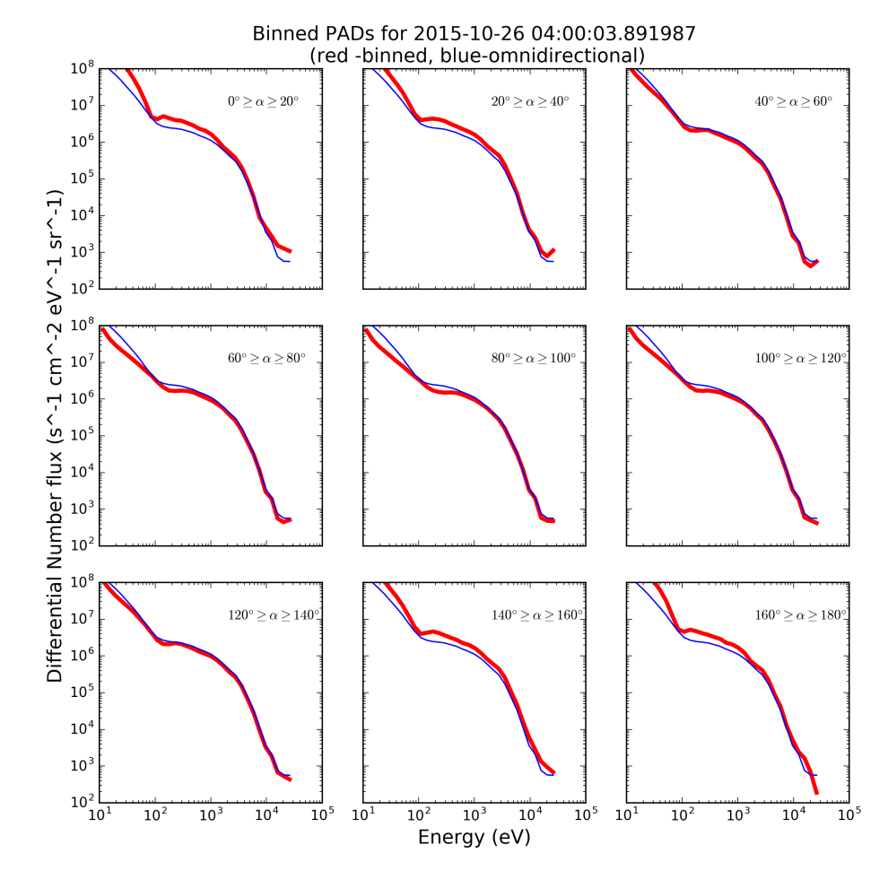
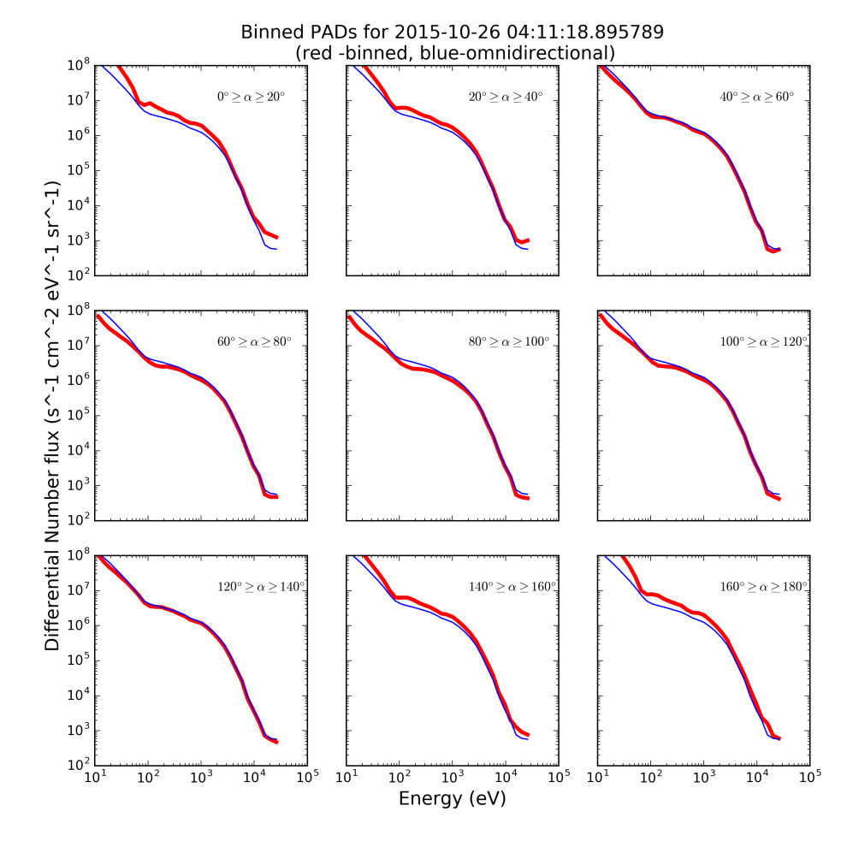
PA-limited spectra for Selected Times

Slide 6
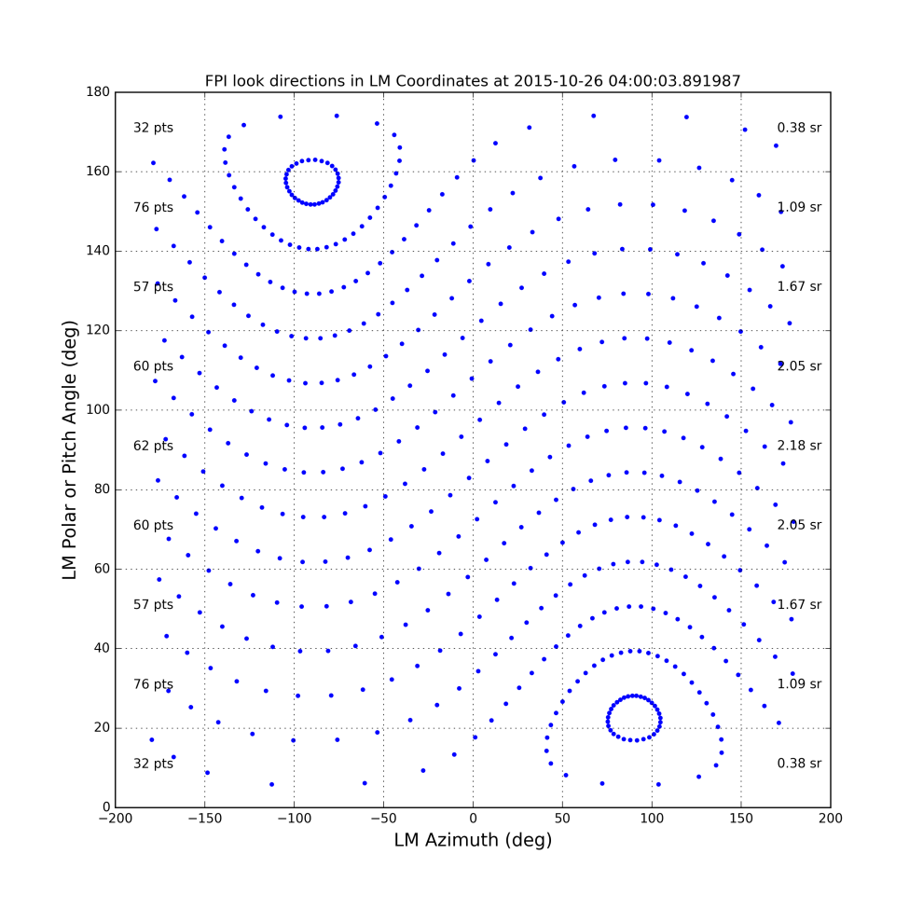
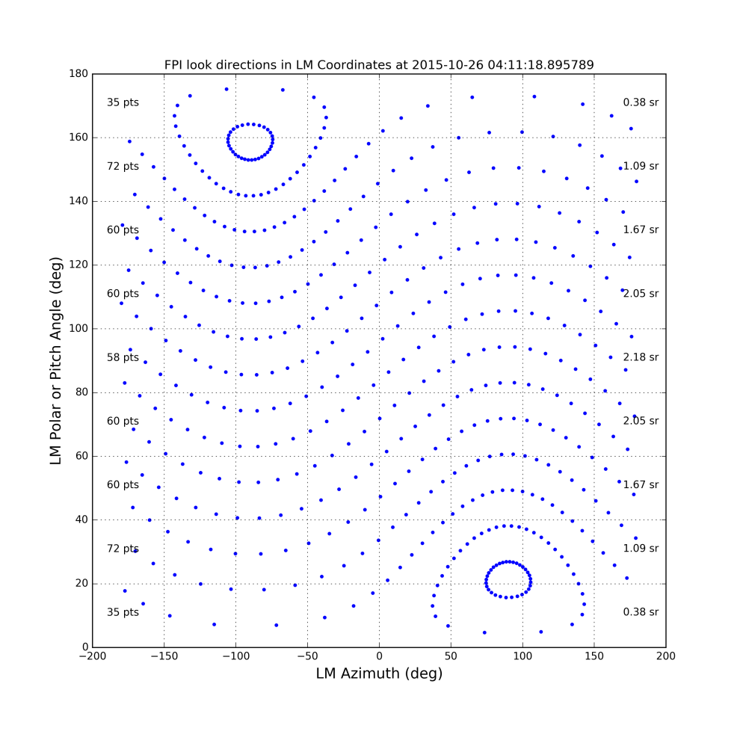
Instrument Views in LM Coordinates

Slide 7
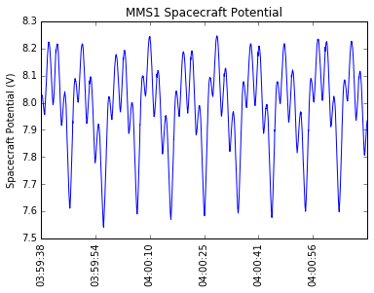
Spacecraft Potential
ASPOC control of spacecraft potential keeps it below the lowest FPI bin
Spacecraft generated photoelectrons can be ignored

Slide 8
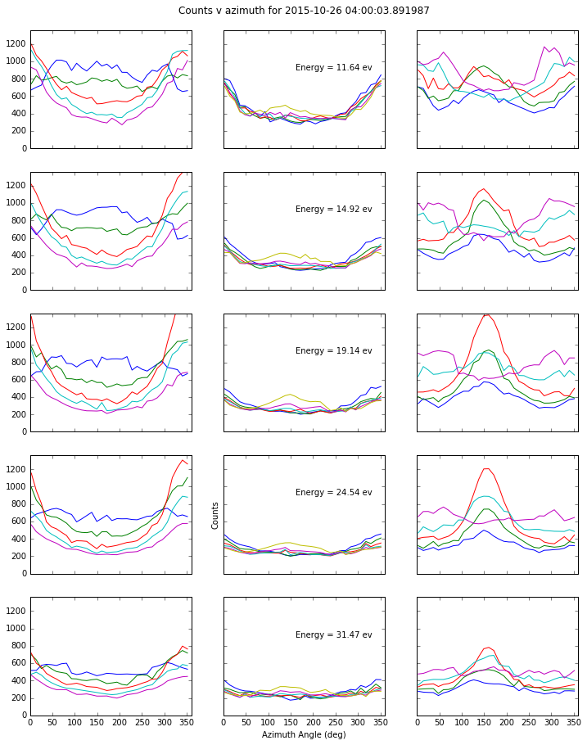
Gyrotropy
Pressure tensor in DBCS
Eigenvalues indicate gyrotropy
λ_{i} = (0.056, 0.069, 0.070)
Low energy counts show strong photoelectron influence
Seemed worrisome

Slide 9
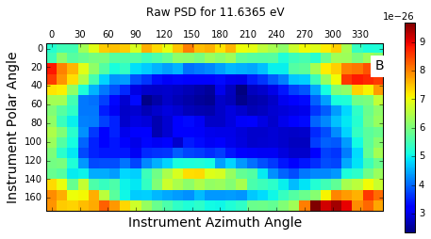
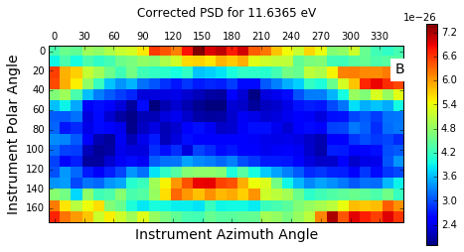
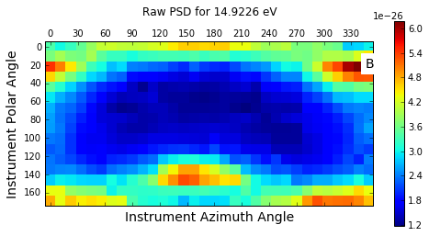
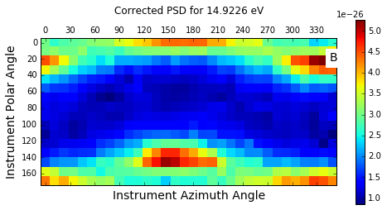
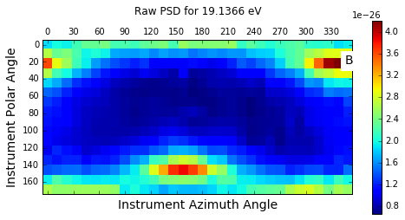
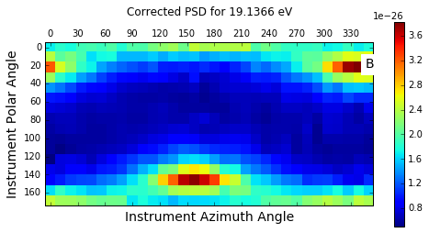
Corrections for Internal Photoelectrons

